Slide 1
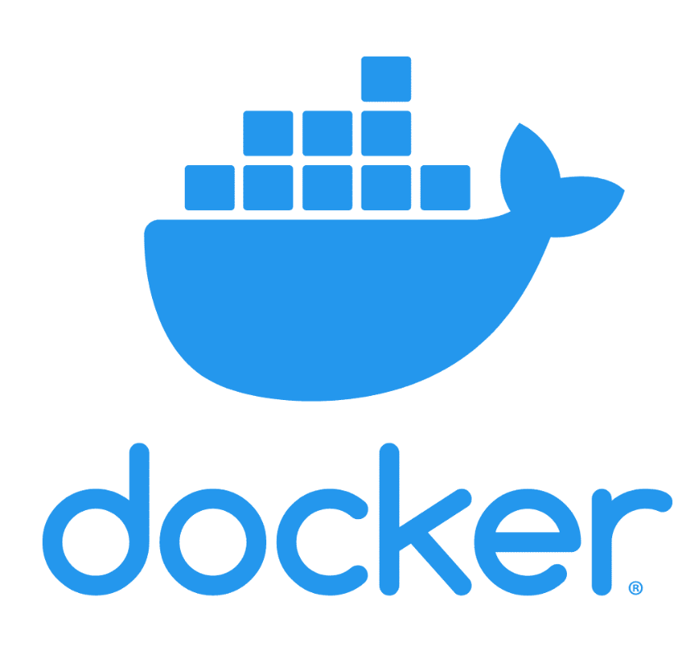

Slide 2
What is Docker ?
Docker is an open source platform for developing, shipping, and running applications
Docker enables you to separate your applications from your infrastructure so you can deliver software quickly

Slide 3
Evolution of docker
Bare-metal server
Virtual machine
Containers

Slide 4
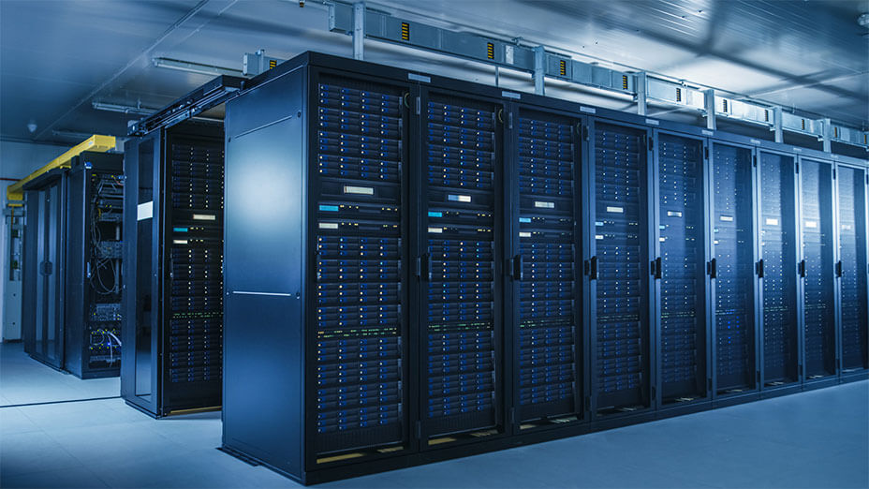
Bare-metal server

Slide 5
Bare-metal server
A bare-metal server is a physical computer server that is used by one consumer, or tenant, only.
Each server offered for rental is a distinct physical piece of hardware that is a functional server on its own

Slide 6
Flaws of Bare-metal server
Expensive
Complex management,
Complex updating,
Difficulty in scalability

Slide 7
Virtualization
Virtualization is the creation of a virtual -- rather than actual -- version of something, such as an operating system (OS), a server, a storage device or network resources.
Virtualization uses software that simulates hardware functionality to create a virtual system.

Slide 8
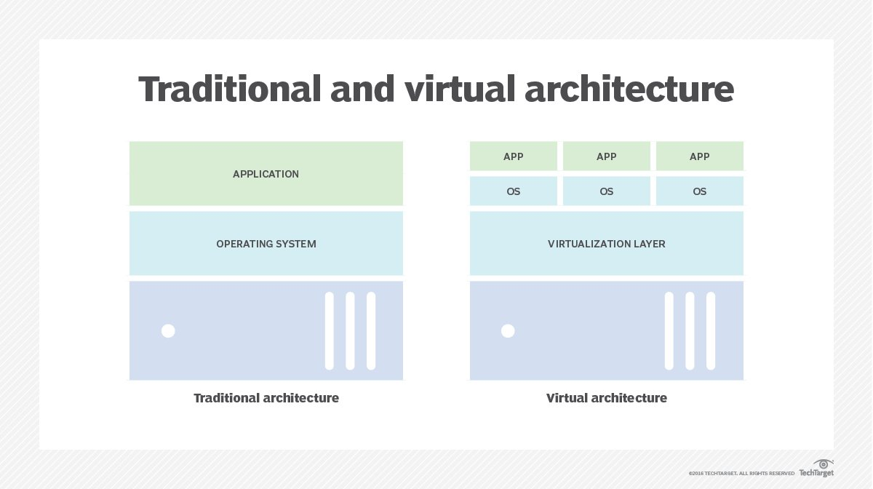
Virtualization

Slide 9
Advantages of Virtualization
Uses Hardware Efficiently.
Over subscription can be done
Security
Isolation of applications

Slide 10
Flaws of Virtualization
High Initial Investment
Data Can be at Risk
Quick Scalability is a Challenge
Performance Witnesses a Dip

Slide 11
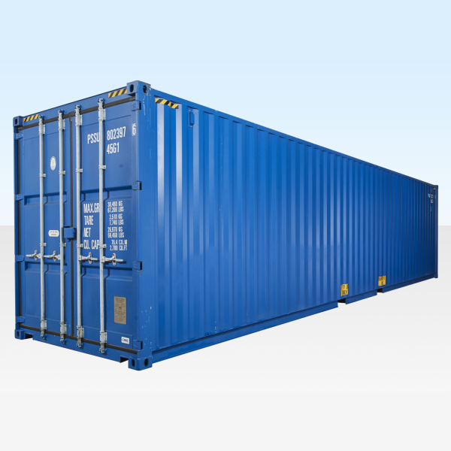
Container

Slide 12
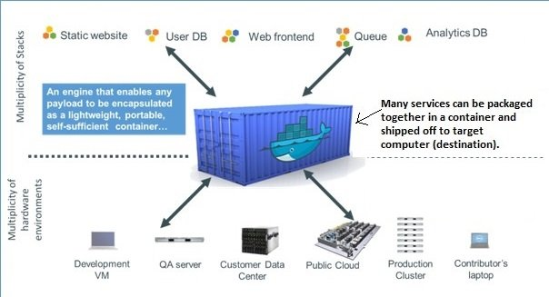
Containerization

Slide 13
Containerization
Containerization involves encapsulating or packaging up software code and all its dependencies so that it can run uniformly and consistently on any infrastructure.
It even encapsulates underlying operating system
It only uses the part of an operating system which is really needed for our code to be running

Slide 14
Advantages of docker
With Docker, you can manage your infrastructure in the same ways you manage your applications.
By taking advantage of Docker’s methodologies for shipping, testing, and deploying code quickly, you can significantly reduce the delay between writing code and running it in production.

Slide 15
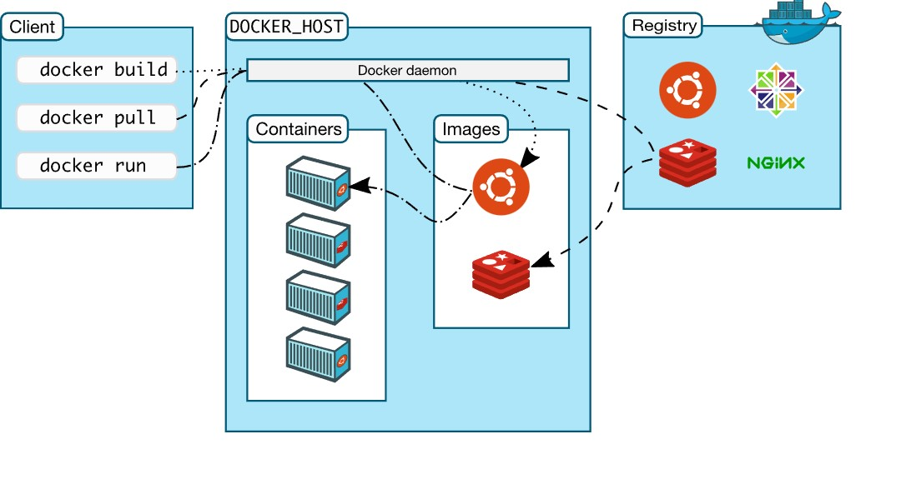
Docker architecture

Slide 16
Docker architecture
Docker uses a client-server architecture. The Docker client talks to the Docker daemon, which does the heavy lifting of building, running, and distributing your Docker containers.
The Docker client and daemon can run on the same system, or you can connect a Docker client to a remote Docker daemon

Slide 17
Docker terminology
The Docker daemon:-
The Docker daemon (dockerd) listens for Docker API requests and manages Docker objects such as images, containers, networks, and volumes.
A daemon can also communicate with other daemons to manage Docker services

Slide 18
Docker terminology
The Docker client:-
The Docker client (docker) is the primary way that many Docker users interact with Docker. When you use commands such as docker run, the client sends these commands to dockerd, which carries them out.
The docker command uses the Docker API.
The Docker client can communicate with more than one daemon.

Slide 19
Docker terminology
Docker Desktop:-
Docker Desktop is an easy-to-install application for your Mac, Windows or Linux environment that enables you to build and share containerized applications and microservices.
Docker Desktop includes the Docker daemon (dockerd), the Docker client (docker), Docker Compose, Docker Content Trust, Kubernetes, and Credential Helper.

Slide 20
Docker registries
A Docker registry stores Docker images. Docker Hub is a public registry that anyone can use, and Docker is configured to look for images on Docker Hub by default. You can even run your own private registry

Slide 21
Installation
Download docker desktop from https://www.docker.com/products/docker-desktop/

Slide 22
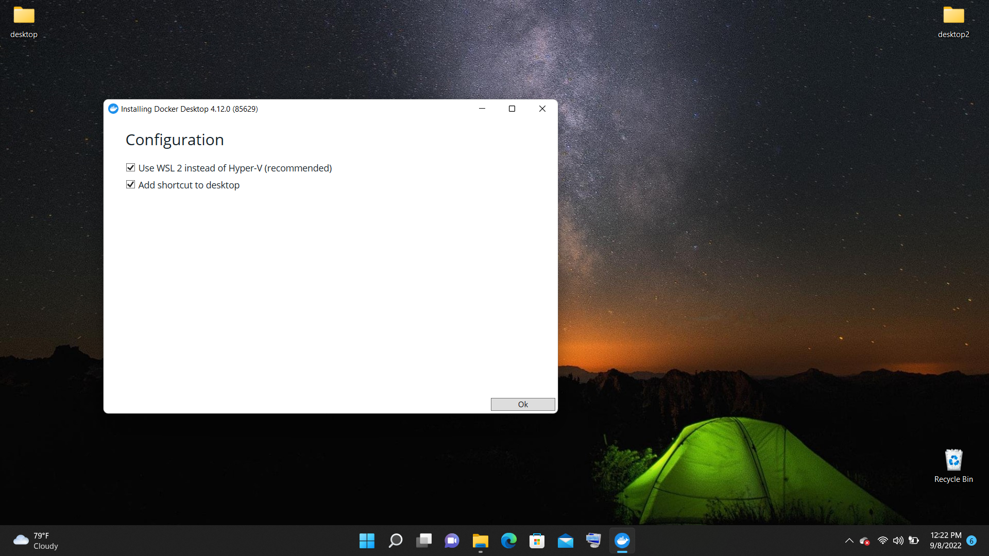

Slide 23
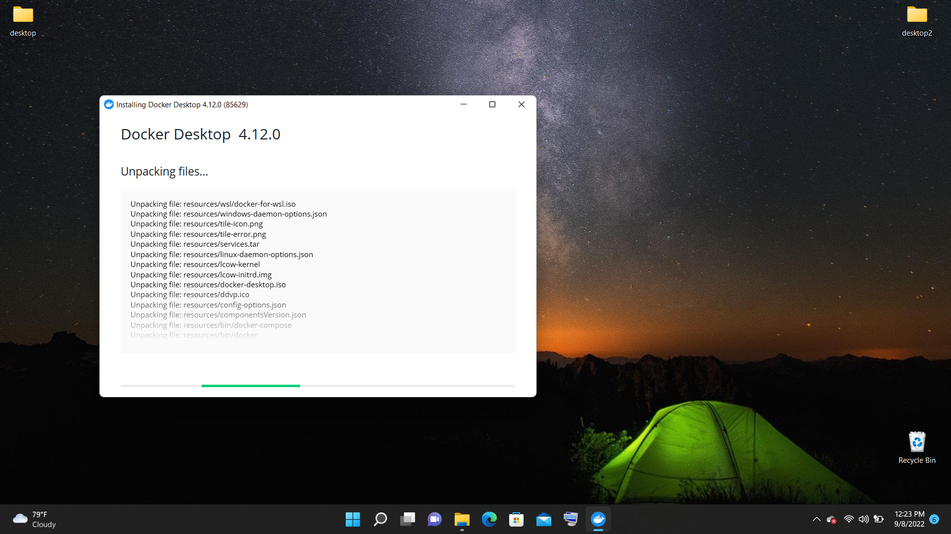

Slide 24
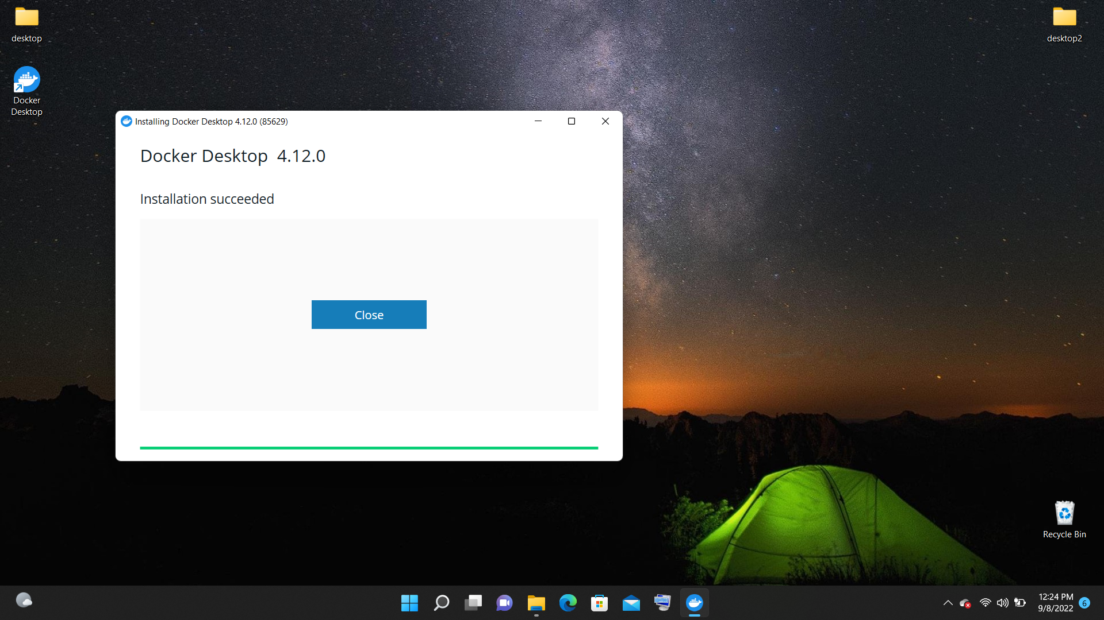

Slide 25
Play with Docker
PWD is a Docker playground which allows users to run Docker commands in a matter of seconds. It gives the experience of having a free Alpine Linux Virtual Machine in browser, where you can build and run Docker containers

Slide 26
Writing First docker file
FROM ubuntu:18.04
RUN echo "hello"
CMD echo “HELLO ALL“
Save the file with the name Dockerfile

Slide 27
Docker instructions
FROM
COPY
ENV
RUN
EXPOSE
LABEL
USER
WORKDIR

Slide 28
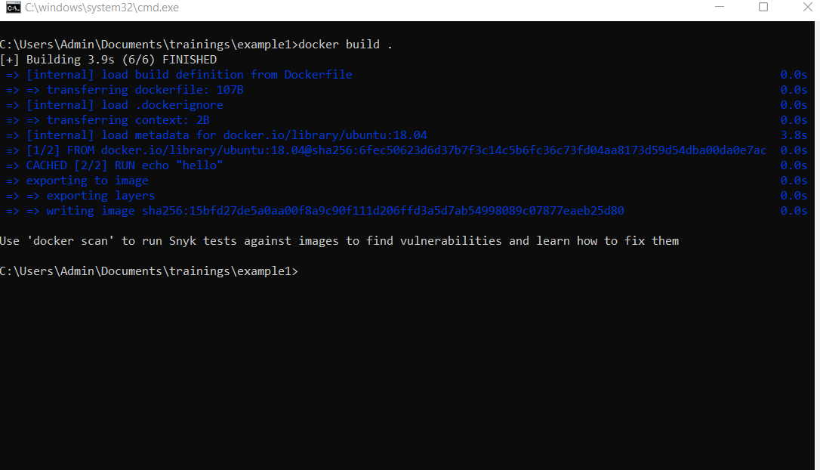
Building a docker image
Docker build . – command creates docker image in local

Slide 29
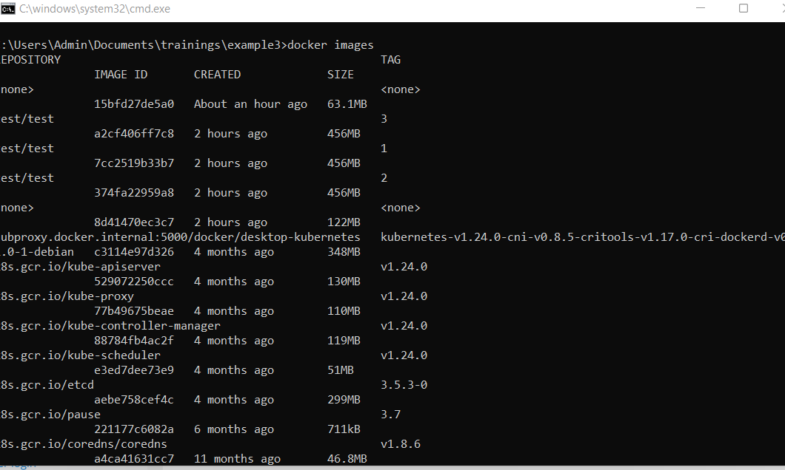
Docker images
Docker images

Slide 30
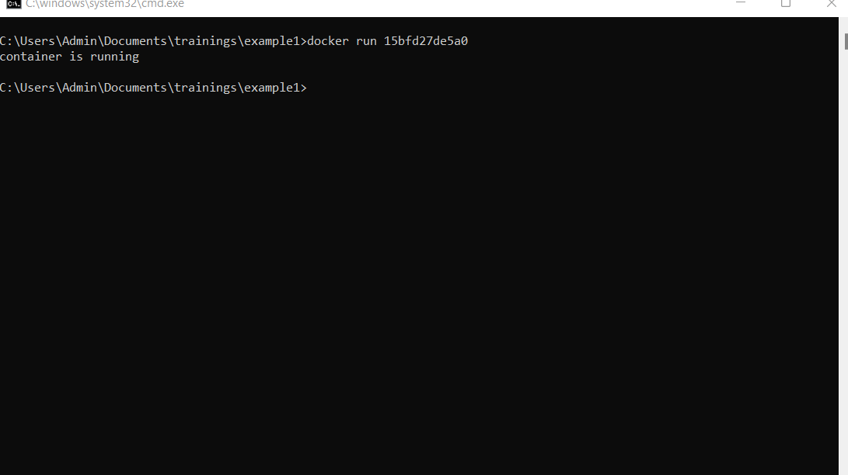
Docker run
Docker run <imageid>

Slide 31
Docker commands
Docker version
Docker images
Docker build
Docker run
Docker start
Docker stop
Docker rmi
Docker rm
Docker tag
Docker login

Slide 32
Docker commands
Docker pull
Docker push
Docker save
Docker exec
Docker ps
Docker ps –a
Docker ps –l
Docker Search

Slide 33
Examples
Run echo “hello”
Create folders container
Using Arguments
Using Environment variable
Copy files to container
Running a shell script
Running a python script
Running a dotnet code

Slide 34
Whats Next?
Docker tag
Docker registry
Docker repository
Docker push
Docker compose
Docker Context

Slide 35
Docker volumes
Containers will have a virtual file system
Host machine will have physical file system
Virtual file system will be deleted once the container is deleted
We can mount host volume into virtual volume

Slide 36
Types of volumes
Host volume
Ammoniums file system
Named volumes

Slide 37
Docker Repository
The Registry is a stateless, highly scalable server side application that stores and lets you distribute Docker images. The Registry is open-source, under the permissive Apache license.
You can find the source code on GitHub.

Slide 38
Docker compose
Docker compose is used for multi container application
Multi container application are project with more than one containerized microservices , combinedly the serve a common purpose

Slide 39
How to write docker compose
We need to create a docker-compose.yaml file
Yaml (YAML stands for yet another markup language)
We use : (colon to separate key value)
We use space or tab to define an sub level
We use – to define an array

Slide 40
Yaml Examle
foo: bar
pleh: help
stuff:
foo: bar
bar: foo

Slide 41
Example docker-compose
Version: 3.8
Services:
servicea:
Buld:/app1/
Ports:
- 3000:3000
Envirnmeny:
-xyz:xyz
Serviceb:
Build: /app2
3001:3001
Servicec:
image: xyz/app3:
Ports:
27017:27017

